Slide 1
Information about the Coronavirus
26th February 2020

Slide 2
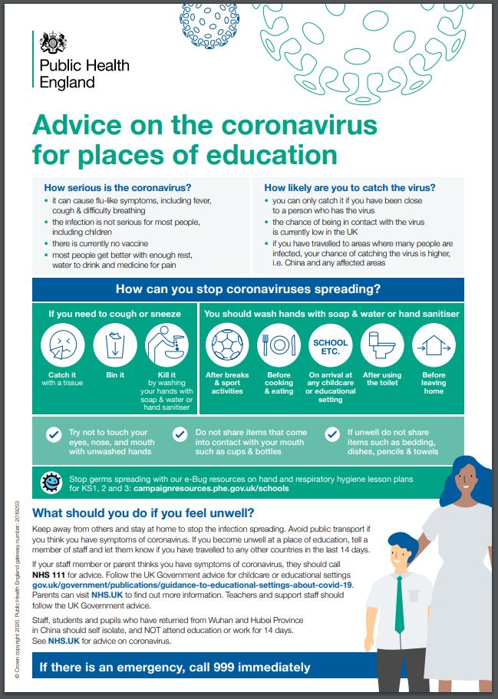
Public Health England
Public Health England have sent out his information to schools

Slide 3
The symptoms of coronavirus
a cough
a high temperature
shortness of breath
However…
These symptoms do not necessarily mean you have the illness.
The symptoms are similar to other illnesses that are much more common, such as cold and flu.

Slide 4
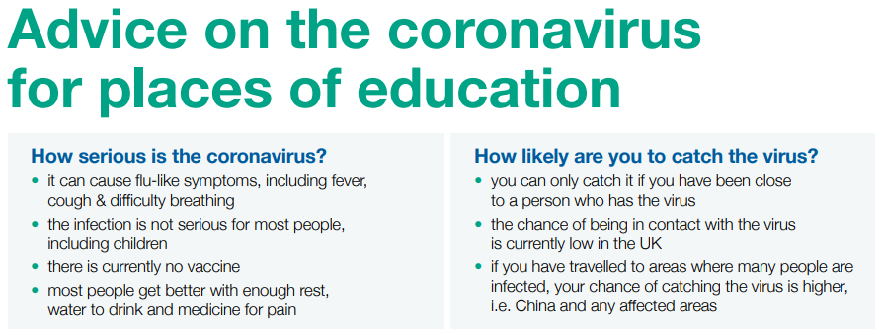

Slide 5
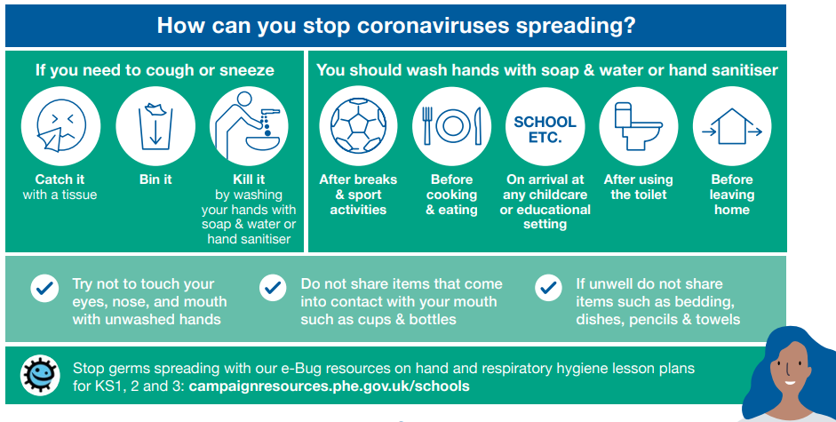

Slide 6
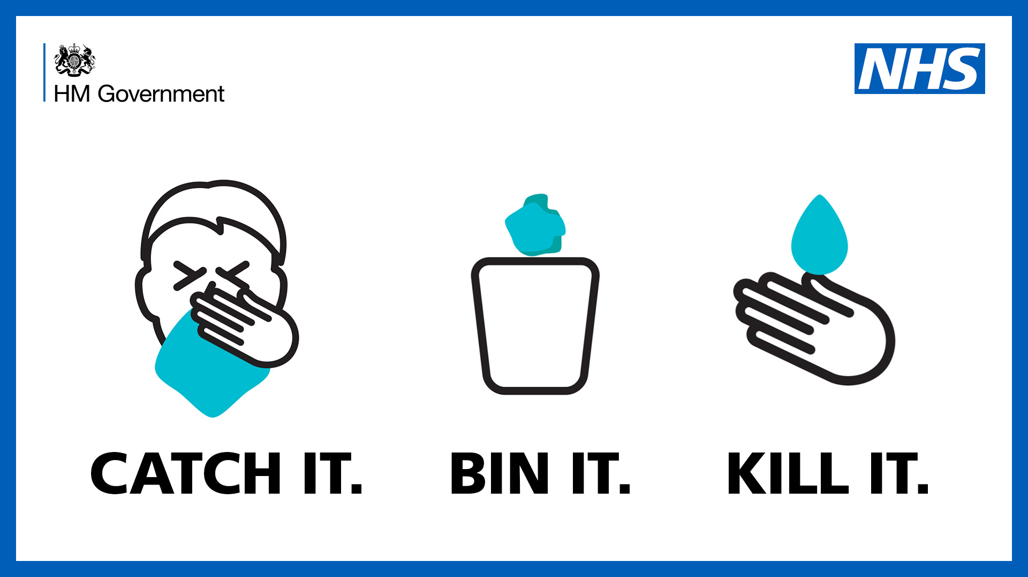

Slide 7


Slide 8


