Slide 1

Parents Induction Meeting
Tuesday 11th June 2019

Slide 2
Welcome to the school
We hope that by the end of this evening you will have:
up-to-date information about the school, including a New Parents Information Pack
an opportunity to meet the Headteacher and Deputy Headteacher
a greater knowledge of what our school is like
time to ask questions

Slide 3
Headlines
Sunday Times top 500 schools list
Top 10% of schools nationally
Most oversubscribed school in Hertfordshire
80% of children gained a place at a consortium secondary school in 2018
2 scholarships to Eton
Pearson Teacher of the Year Award
Winner of the Hertfordshire Primary Maths Challenge 2019
2017 Primary Maths Challenge, highest maintained school in the world

Slide 4

‘…the headteacher and senior leadership team (SLT) have created, and sustain, an enviable culture of excellence (both academic and artistic) and the valuing of lifelong learning and high aspiration. As a result, pupils are exceptionally well prepared for the next step of their education’.
(Hertfordshire Improvement Partner)

Slide 5
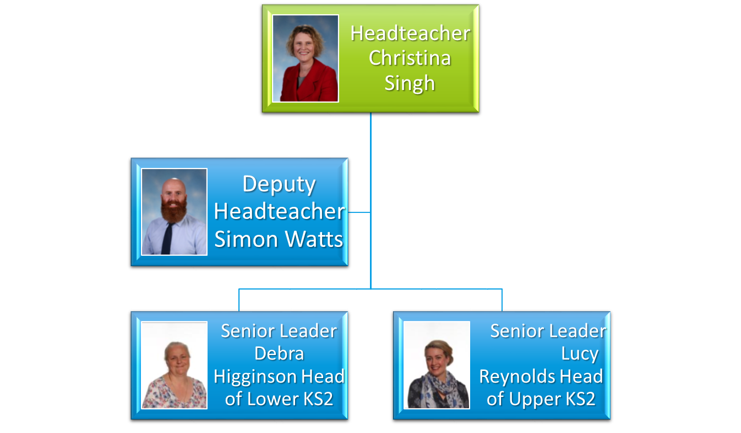
Senior Leadership Team

Slide 6
What is our vision?
We are a community of learners, fostering and developing a life-long love of learning

Slide 7
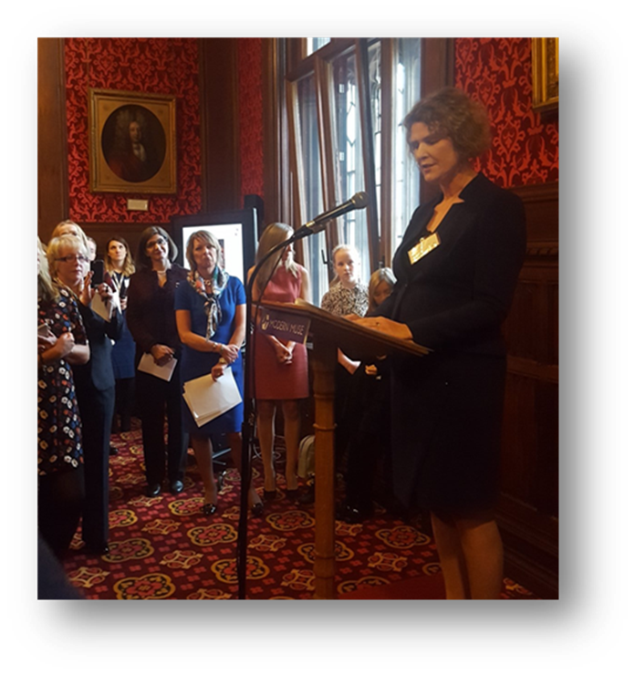
House of Commons

Slide 8
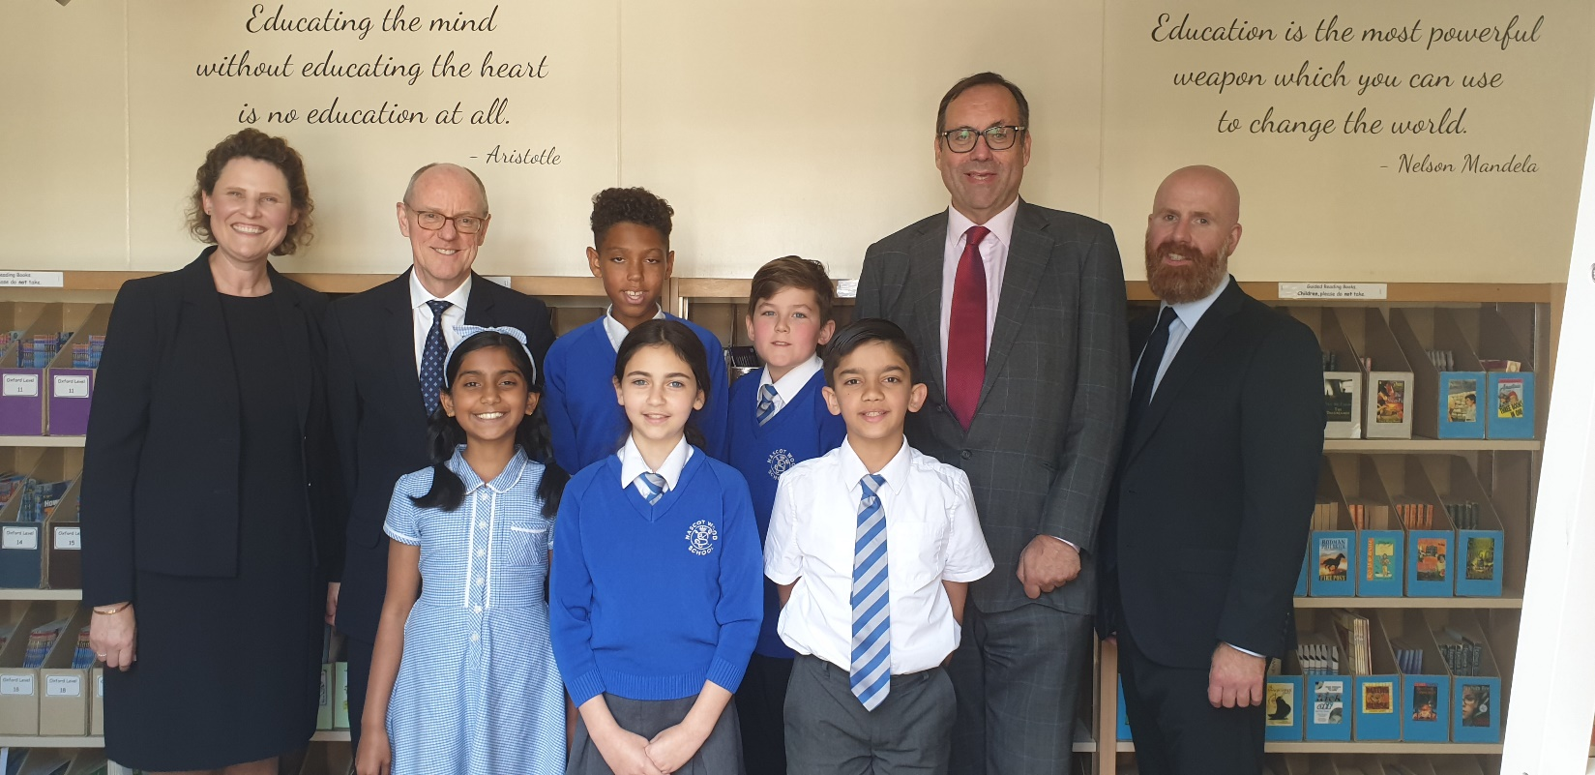
Visit of the Rt Hon Nick Gibb, Minister of state for school standards

Slide 9
What is NWJS like?
We are a friendly school, with a calm atmosphere
We positively reinforce and model the highest standards of behaviour
We have an experienced staff
We value all our pupils and are committed to ensuring that they all achieve their potential
We want to engage and work in partnership with parents, because you know your children best
We aim to provide a stimulating learning environment that gives all children access to a broad and balanced curriculum

Slide 10

Promoting positive mental health

Slide 11
Financial information
£21,000 invested in Maths Whizz
£150,000 invested in the swimming pool
£1,000,000 investment in the school building
£12,000 maintenance for the woodland

Slide 12
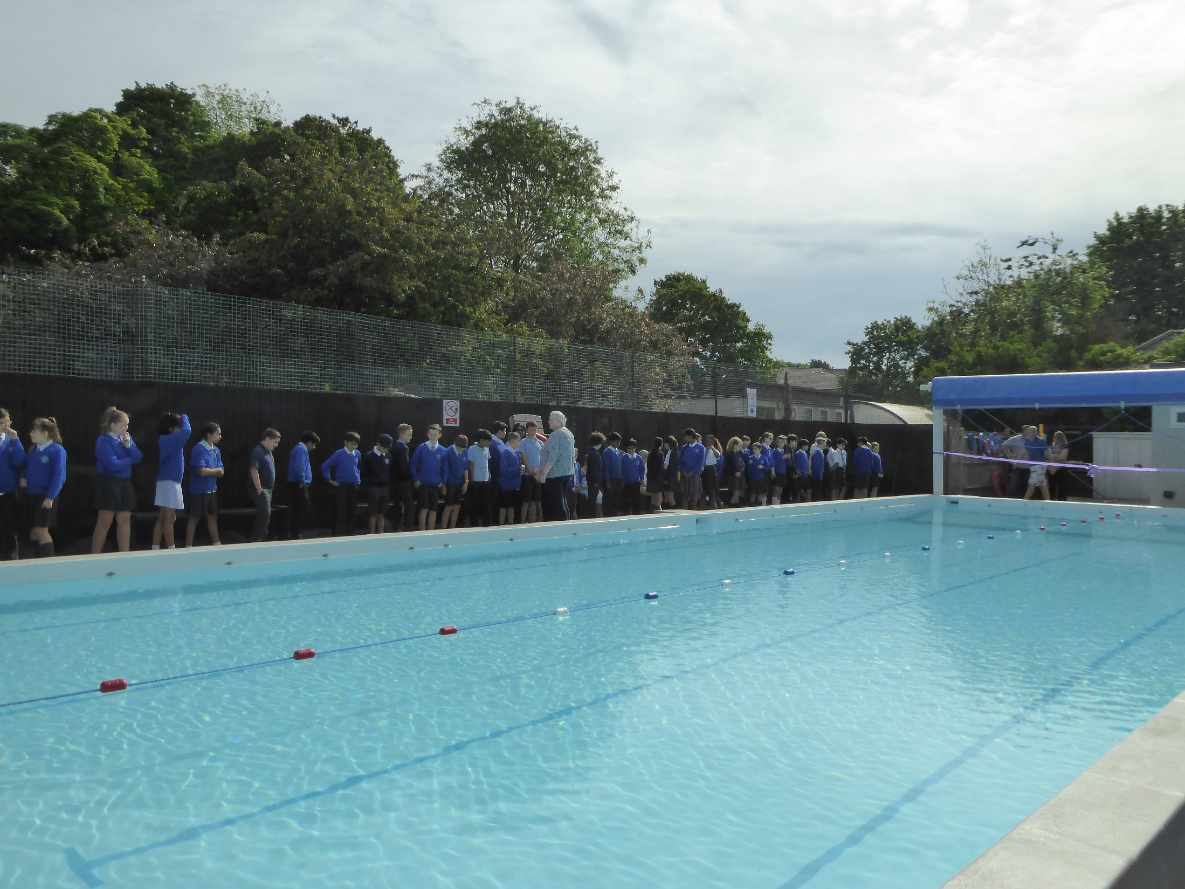

Slide 13
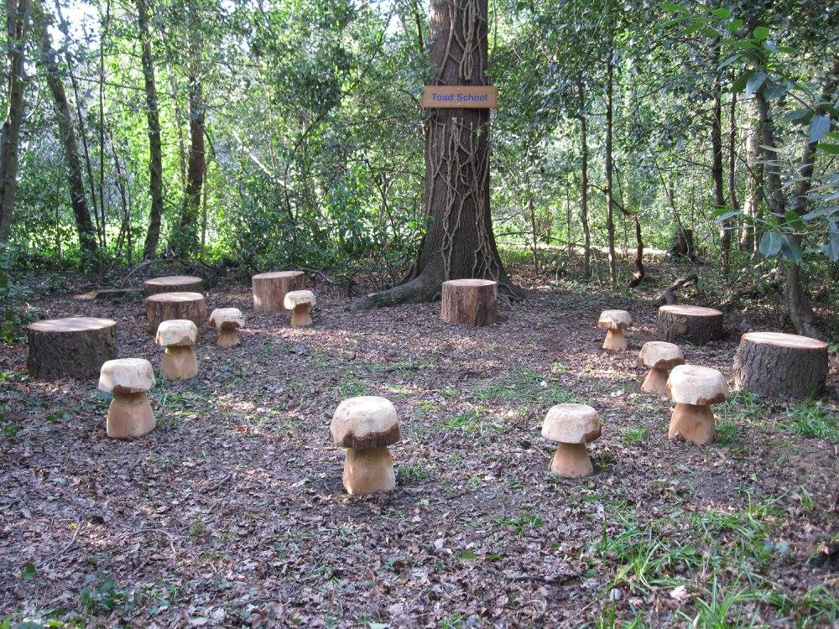

Slide 14
Financial information; 5 year projection

Slide 15
How can you help the school financially?
We are not asking parents for annual financial support, therefore:
Pay a contribution for all trips and events
Communicate any difficulty with payments to the school

Slide 16
2018 SATs results
% of children achieving expected standard in Reading, Writing and Mathematics

Slide 17
2018 SATs results
% of children achieving the higher standard in Reading, Writing and Mathematics

Slide 18
2018 SATs results

Slide 19
2018 SATs results

Slide 20
Secondary School Places 2018

Slide 21
Attendance 2017-2018: 97.0%
In order to ensure that children are making progress and achieving to a high standard, it is essential that we have high levels of attendance, and that these levels are rigorously monitored

Slide 22
Absence

Slide 23
What can I do to ensure that my child makes progress?
Bring your child into school before a medical appointment to be registered, and bring them back
If you need to take your child out of school early, please try to do so after 1.15pm
Ensure that your child has enough sleep and enough play
Limit time on electronic devices
Do not take your child on holiday during term time (13 weeks per year plus Bank Holidays)
Support the work of the school

Slide 24
Homework
Key Skills Daily Reading
30 minutes per day, 6 days per week
Wide range of material, with emphasis on the classics
Key Skills Spelling
Spelling is taught as part of the English curriculum
Statutory spelling lists are available on the school’s website
Key Skills Times Tables
Times Tables should be practiced daily
Year 4 children are expected to know all their tables and will be tested on these from next year
Recommended reading lists on the school’s website
Reading records must be completed and signed daily
Spelling foci can be found in the ‘next week’s learning’ section of the website
Useful resources include Carol Vorderman’s Times Tables books and BBC Bitesize
Mathematics*
Maths Whizz
Mathletics
Komodo
Class Investigations
These will be set by your child’s Class Teacher
Encourages the development of learning autonomy
Participation is pupil led/voluntary

Slide 25
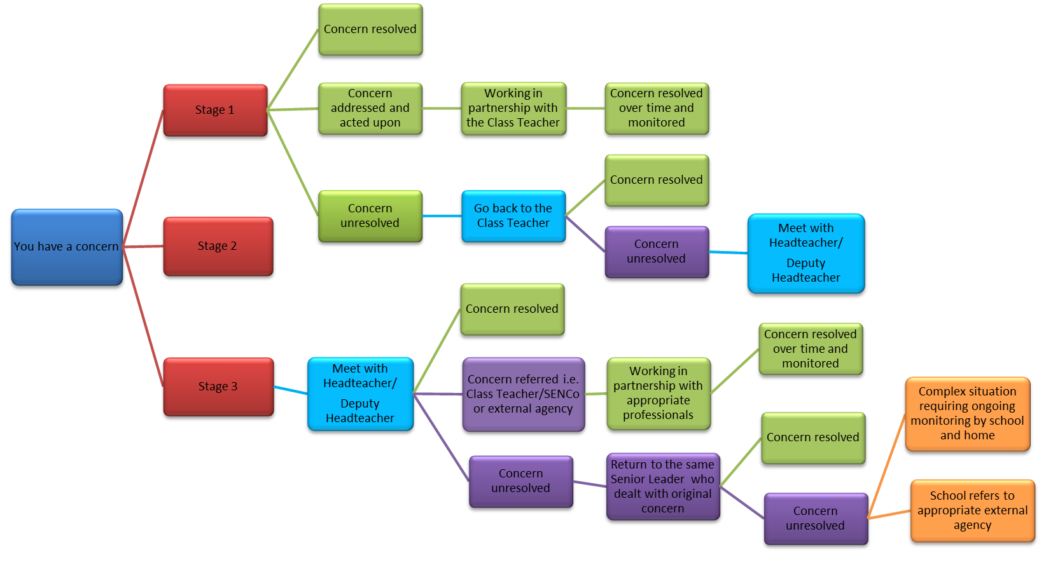
Parental concern flowchart
Stages 1&2 are dealt with by the Class Teacher

Slide 26
When you have concerns…
In the first instance, please raise your concerns with the Class Teacher
All Class Teachers are willing to meet with parents after school, so please book an appointment when necessary
The Headteacher and Deputy Headteacher are available to speak to each morning, and will pass information to the Class Teacher or the school office
If you want to contact the Class Teacher, Deputy Headteacher or the Headteacher by email, please do so at admin@nascotwoodjm.herts.sch.uk or contact them by telephoning the school office on 01923 238784

Slide 27
What can you expect from us?
We will behave in a professional manner
We will always treat you with respect and courtesy
We will maintain confidentiality and never discuss your child with anyone else
We often respond to an initial concern within 24 hours, but will always respond within 3-5 working days after the concern has been raised/received
We will investigate your concerns and work hard to find a solution that is effective
We will communicate your concerns, when appropriate, to other members of staff

Slide 28
What can you expect from us?
We will supply you with information about your child’s progress at the Autumn Term Parent’s consultation evening, the Spring Term Annual Report and the Summer Term Parent’s consultation afternoon
If you have concerns about your child’s progress at any other time of the year, we will provide you with the most up to date information
We will contact you if we have any concerns about your child, and identify ways that we can help

Slide 29
What will we provide for the children?
A happy and nurturing environment
A broad and balanced curriculum
A community where they will be listened to, and their opinions respected
An inclusive school, where diversity is valued
A positive learning environment with an emphasis on challenge
High expectations and aspiration for the future for all children
A model of behaviour
Positive praise and encouragement

Slide 30
What will we expect from you?
Courteous, calm and measured behaviour at all times
Parents should ensure that children complete their home learning each week
Members of staff and/or the school should not be discussed on social media sites, including class whatsapp groups
Parents should take time to read communication sent from the school e.g. newsletter, letters on the school’s website
Parents will be expected to financially contribute to school trips
Parents will be asked to complete Parent view or a parent questionnaire annually (parentview.ofsted.gov.uk)

Slide 31
What will we expect from you?
All members of staff must be treated with respect and courtesy
Concerns, queries and complaints should be raised in the first instance with the Class Teacher, and then, if necessary with a member of the Senior Leadership Team
The school must be given time to deal with your concern and find a solution that is effective. We may not find that solution at the first attempt
Ensure that your child attends school every day and arrives promptly
Ensure that your child wears the correct uniform
Parents must not admonish children on the school site who are not their own

Slide 32
Essential Reading for Parents
Document | Where do I find it? | How often should I read it?
Behaviour Policy | Brochure/School website | When my child starts at Nascot Wood Junior School/when necessary
Home-School Agreement | Brochure | When my child starts at Nascot Wood Junior School/when necessary
This week’s learning | School website in appropriate class section, updated during PPA | Weekly (Tuesday: Year 3, Wednesday: Year 4, Thursday: Year 5, Friday: Year 6)
School newsletter | School website/email | Monthly
Reading records | School bag | Daily and signed weekly
Headteacher’s termly report | School website | Termly
Children’s annual reports | Hard copy | Spring term
School website | www.nascotwoodjm.herts.sch.uk | Weekly

Slide 33

Must read…

Slide 34



Must read…

Slide 35
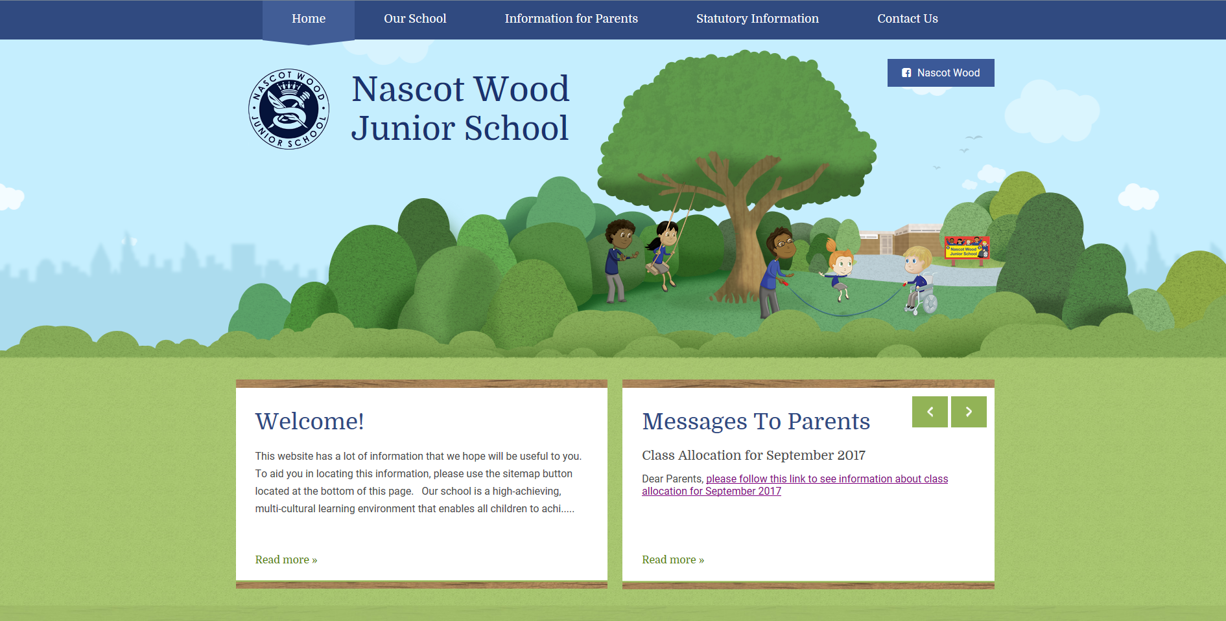
School Website

Slide 36
What will we expect from the children?
Do their best
Behave with respect and fairness to all
Be kind and helpful
Tell the truth
Let their Class Teacher or Teaching Assistant know if they have any worries
Take all letters home
Keep the school clean and tidy
Respect all equipment
Follow safety procedures

Slide 37
Year 3 2019/20
Willow and Holly
Miss Derbyshire, Mrs Keane
Classes will be mixed by Nascot Wood Infants School, based on a balance of girls and boys, SEND and EAL
You will receive an information letter on Tuesday 10th July
Please drop in after school to meet your child’s Class Teacher should you wish to

Slide 38
Our curriculum offer
Bespoke provision
Enhancement activities
National Curriculum

Slide 39
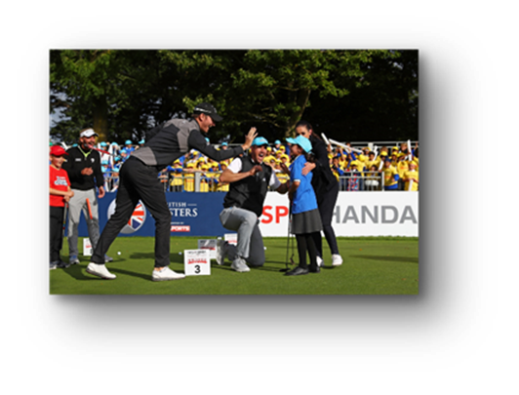
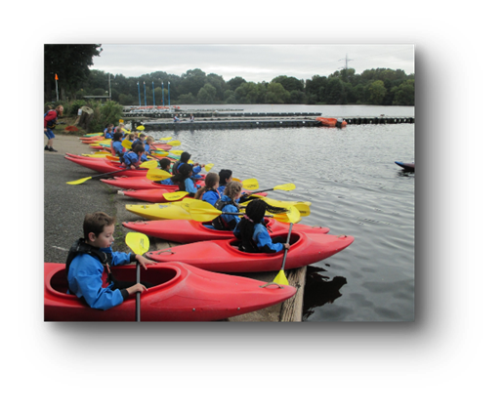
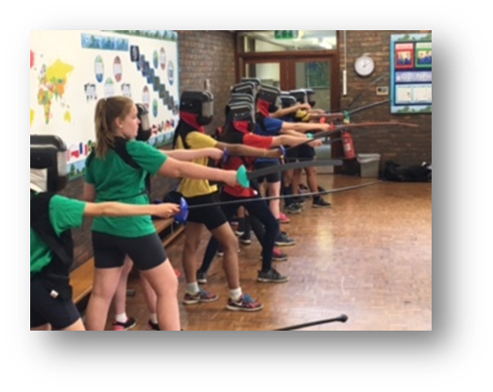
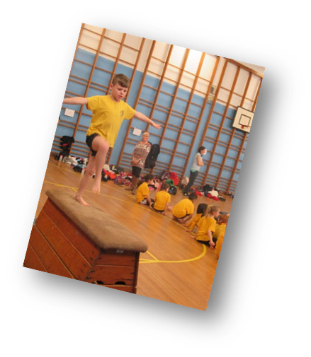
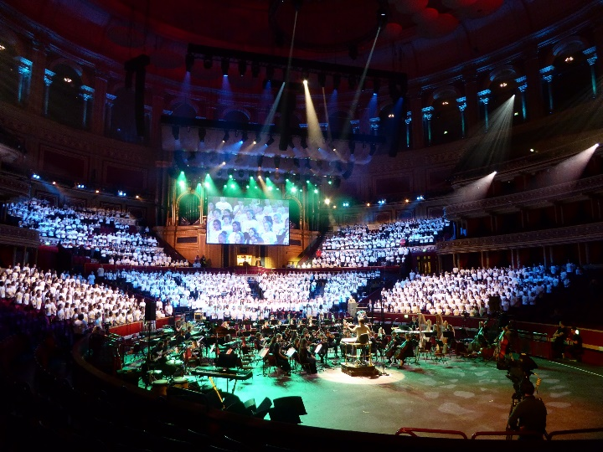

Slide 40
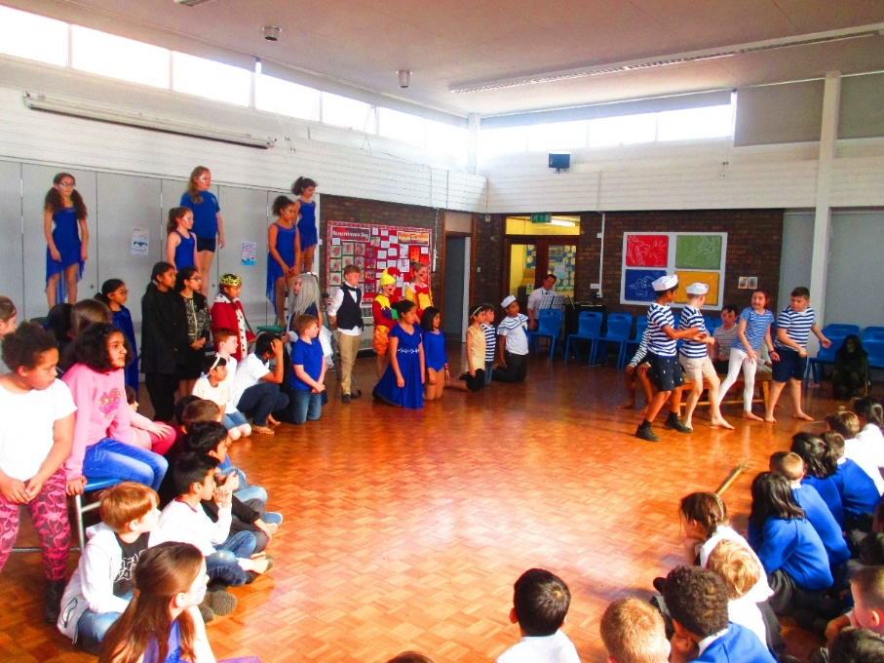
The Tempest

Slide 41


Slide 42
Behaviour
Behaviour at this school is described by the Local Authority as outstanding
We set high standards, and the children respond with behaviour that is predominantly exemplary
The high standards of behaviour enable us to give the children opportunities and a certain amount of freedom
We try to always use a restorative approach (Hertfordshire STEPS)

Slide 43
Behaviour (Rewards)
Positive reinforcement, praise, reward stickers & post its
House points
Achievement assembly
Golden Time
Gold Book award
Golden tea party
Achievement trophy
Head and Deputy Head teacher's awards
Star of the week

Slide 44
Behaviour (Sanctions)
The Behaviour sanctions are levelled 1-5
Level 1 is relatively low level for example, talking in class or being unkind to someone else
Level 4 and 5 are serious, and a Level 4 behaviour letter will be sent to parents to inform them of the incident that has taken place
Level 5 behaviour may result in a fixed term or permanent exclusion

Slide 45
Accidents at school
If your child has a minor injury whilst at school, they will be seen by a member of staff trained in first aid
If the injury is considered by the school to be minor, you will not be notified
If your child receives a bump to the head, they will be brought to the medical room. An assessment will be made, and we will contact you. You will also receive a ‘bump note’ and your child will be given a red sticker to wear
In the case of an emergency, we will call an ambulance and then contact you to inform you. If you have not arrived by the time the ambulance does, a member of staff will accompany your child to the hospital
Any first aid that we give is a temporary solution until you can assess your child at the end of the school day

Slide 46
What is safeguarding?
We have a duty to ensure that children are kept safe
If we are concerned about information which suggests a child is being neglected or experiencing physical, emotional or sexual harm, we will report this to Children’s services
The school has a Designated Senior Person (Headteacher) who deals with any Safeguarding concerns
In my absence, the Deputy DSP (Deputy Headteacher) deals with any concerns
Safeguarding information will be given to your child

Slide 47
What is E safety and why is it important?
E safety is about keeping children safe in a digital world
It is an important part of child protection
E safety is led and managed by the ICT coordinator, Mr Watts
Mr Watts runs regular workshops for parents to keep you informed of potential risks for your children, and how to monitor these

Slide 48
Bullying
We define bullying as emotionally or physically harmful behaviour which is:
Repetitive, wilful or persistent:
Intentionally harmful, carried out by an individual or a group;
Based on an imbalance of power leaving the person who is bullied feeling defenceless

Slide 49
Bullying
Bullying can happen in any environment that includes people
It is important not to confuse one-off incidents of bad/unkind behaviour with bullying
It is important that, as well as protecting children from bullying, we also build their resilience for the future

Slide 50
Bullying
Bullying is not tolerated at our school
Members of staff spend time ensuring the best outcomes when there is conflict between children
We have worked hard to develop a culture where children feel comfortable to tell the truth
Accusations of bullying are taken seriously and dealt with promptly
PSHE and Circle times promote good working relationships
High ratio of adults to children on the playground
Provision is made for children who find the playground difficult
Senior Leaders provide additional support

Slide 51

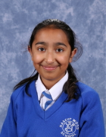
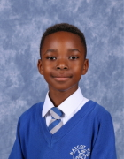
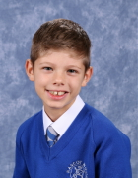
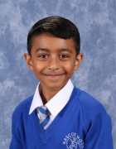
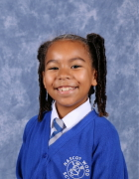
School Uniform
www.stikins.co.uk

Slide 52
Ordering School Uniform
School ties
School jumpers
Sports tops in house colours
Printed name labels
Storm jacket
www.brigade.uk.com
www.beatschooluniforms.co.uk

Slide 53
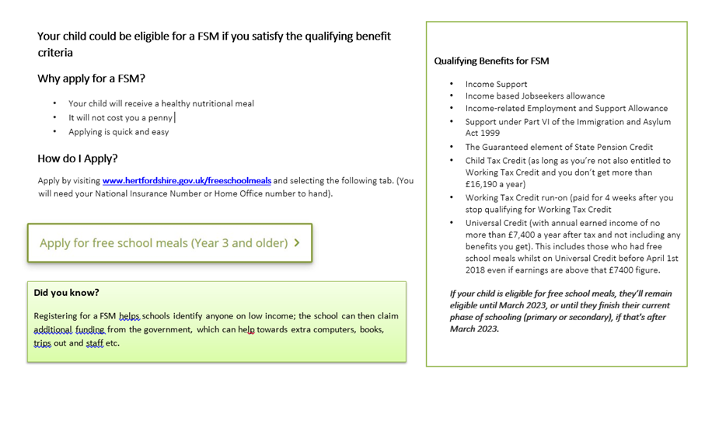

Slide 54

Thank you for listening; any questions?

